Slide 1

Effective In Date | Fixed Lead Time | Dock To Stock
10/01/2026 | 5 | 1
10/19/2026 | 6 | -1
Effective In Date | Pre-Ship Lead Time | Transit Time
10/01/2026 | 2 | 8
10/19/2026 | -1 | 2
Rule: Cumulative,
Type: Make
Site C1001

Slide 2
Safety = 1
DTS = 2
Transit = 2
Pre-ship =1
LTA = 2
Fixed = 2
Variable = 0.2*10 =2
Demand Date | Due Date | Dock Date | Ship Date | Build Date | Start Date
09/25/2026 | 09/24/2026 | 09/22/2026 | 09/20/2026 | 09/19/2026 | 09/13/2026
10/15/2026
10/19/2026

Slide 3
Time Phased Lead Time
Transit Rule: Inclusive
Type: Make
Site: C1001
Safety = 1
DTS = 2
Transit = 2
Pre-ship =1
LTA = 2
Fixed = 2
Variable = 0.2*10 =2
Finding: the values are taken from the a day after effective In date for the demand date as same as effective In date it uses the previous values listed for the demand not the current time phased dates.

Slide 4
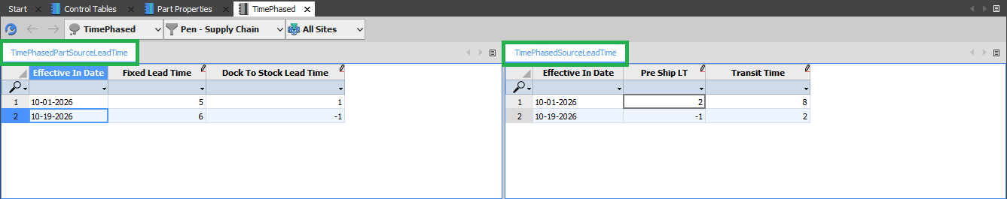
Demand Date | Due Date | Dock Date | Ship Date | Build Date | Start Date
09/25/2026 | 09/24/2026 | 09/22/2026 | 09/20/2026 | 09/19/2026 | 09/13/2026
10/15/2026 | 10/14/2026 | 10/14/2026 | 10/14/2026 | 10/14/2026 | 10/05/2026
10/20/2026 | 10/19/2026 | 10/19/2026 | 10/19/2026 | 10/19/2026 | 10/09/2026

Slide 5
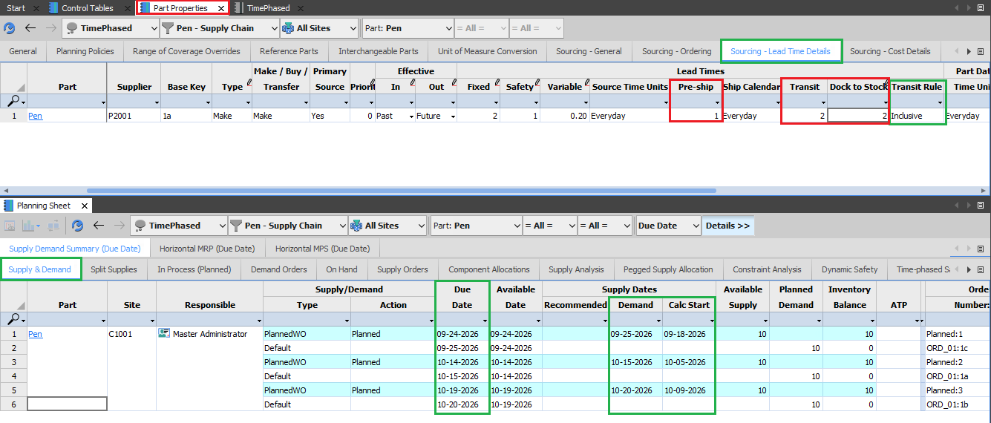

Slide 7
Time Phased Lead Time
Transit Rule: Cumulative
Type: Make
Site: C1001
Safety = 1
DTS = 2
Transit = 2
Pre-ship =1
LTA = 2
Fixed = 2
Variable = 0.2*10 =2
Finding: the values are taken from a day after effective In date for the demand date as same as effective In date it uses the previous values listed for the demand not the current time phased dates.

Slide 8
Demand Date | Due Date | Dock Date | Ship Date | Build Date | Start Date
09/25/2026 | 09/24/2026 | 09/22/2026 | 09/20/2026 | 09/19/2026 | 09/13/2026
10/01/2026 | 09/30/2026 | 09/28/2026 | 09/26/2026 | 09/25/2026 | 09/19/2026
10/15/2026 | 10/14/2026 | 10/13/2026 | 10/05/2026 | 10/03/2026 | 09/24/2026
10/20/2026 | 10/19/2026 | 10/17/2026 | 10/15/2026 | 10/13/2026 | 10/09/2026

Slide 9
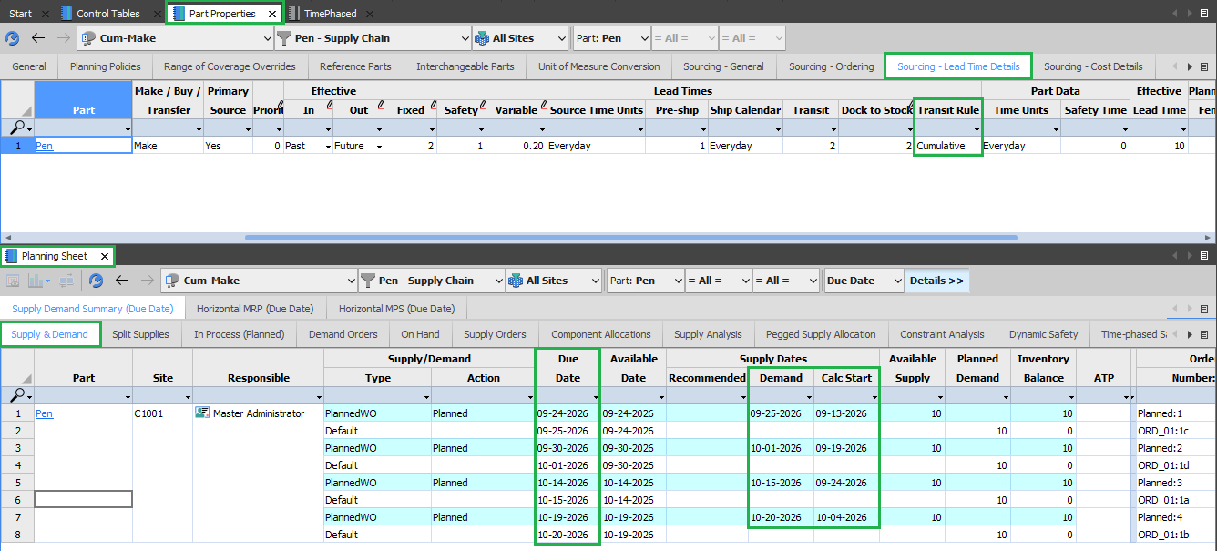

Slide 11
Simulation
Transit Rule: Cumulative
Type: Transfer
Site C1001
Dates | Elements | Values (C1001) | C1001 | Values (C1001 + E3001) | E3001
Demand Date |  |  | 10/15/2026 |  | 10/15/2026
Due Date | Safety | 1 | 10/14/2026 | 1 + 0 | 10/14/2026
Dock Date | Dock To Stock | 2 | 10/12/2026 | 2 + 1 | 10/11/2026
Ship Date | Transit Time | 2 | 10/10/2026 | 2 + 2 | 10/07/2026
Build Date | Pre-Ship | 1 | 10/09/2026 | 1 + 1 | 10/05/2026
 | LTA | 2 |  | 2 + 1
 | Fixed | 2 |  | 2 + 1
 | Var*Qtd | 2 |  | 2 + 0
Start Date |  |  | 10/03/2026 |  | 10/03/2026

Slide 12
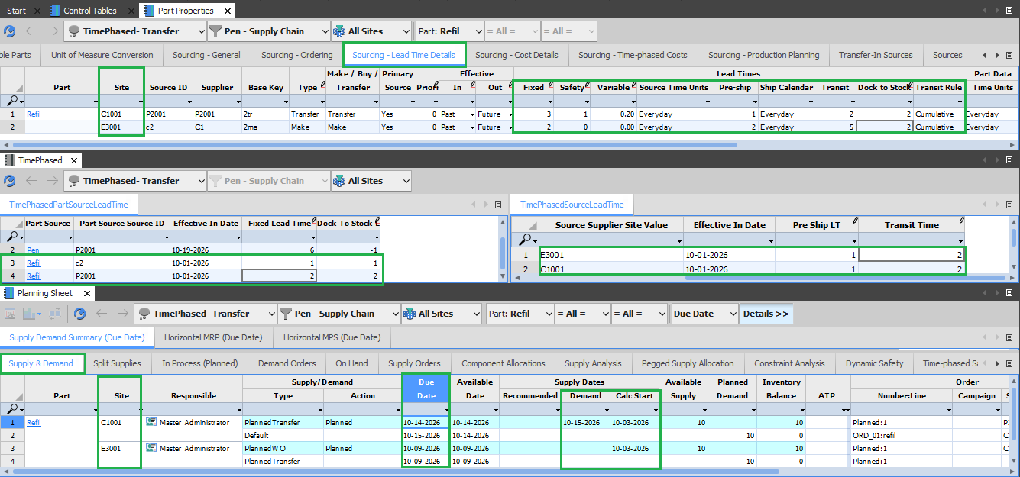

Slide 13
Dates | Elements | Values (C1001) | C1001 | Values (C1001 + E3001) | E3001
Demand Date |  |  | 10/15/2026 |  | 10/15/2026
Due Date | Safety | 1 | 10/14/2026 | 1 + 0 | 10/14/2026
Dock Date | Dock To Stock | 2 | 10/14/2026 | 2 + 1 | 10/12/2026
Ship Date | Transit Time | 2 | 10/14/2026 | 2 + 2 | 10/10/2026
Build Date | Pre-Ship | 1 | 10/04/2026 | 1 + 1 | 10/09/2026
 | LTA | 2 |  | 2 + 1
 | Fixed | 2 |  | 2 + 1
 | Var*Qtd | 2 |  | 2 + 0
Start Date |  |  | 10/08/2026 |  | 10/07/2026

Slide 14
Lead Time Algo

Slide 15
Lead Dates
Demand Date (Need Date / Requirement Date): When the customer or consuming process needs the material available. This is the anchor everything else is calculated from.
Due Date: When the order must be complete or received to meet the demand. In MRP it is often the demand date minus safety lead time (a buffer).
Dock Date: When the goods arrive at your receiving dock. This is the date the supplier or upstream plant needs to deliver to.
Stock Date: When the material is received, inspected, put away, and available for use. Dock date plus dock-to-stock time.
Ship Date: When the supplier or origin plant actually ships. Dock date minus transit time.
Build Date (Production/Completion Date): When production finishes and goods are ready to ship.
Start Date (Release Date / Order Start): When the work order or purchase order must be released or begin, so that it completes on time. Due date minus the lead time.

Slide 16
Lead Time Elements
Pre-ship time: The time the supplier needs to get your order ready before it leaves their warehouse. They receive the PO, find or make the goods, pack them, and do the paperwork. Example: you place the order on Nov 12, and the box is ready to leave on Nov 17. Pre-ship is 5 days.
Transit time: The time the goods spend traveling, from the supplier’s door to yours, whether by truck, ship, or plane (including customs if it crosses a border). Example: the truck takes 10 days.
Dock-to-stock time: The time between the truck arriving at your gate and the goods being ready to sell or use. Staff have to unload, count, check for damage, and put the items on shelves. Example: the truck arrives, and it takes 1 day before the phones can be sold.
Safety lead time: A cushion of extra time you add on purpose. You plan for the goods to arrive earlier than you need them, so a late truck or a slow supplier doesn’t cause a problem. Example: you need the phones on Nov 30, but you plan to have them by Nov 28. The 2 days in between are your safety lead time.
Fixed lead time: The part of the wait that is the same whether you order 1 unit or 1,000. It covers things like machine setup, approvals, waiting in the queue, and transit. Example: a factory always needs 2 days to set up the machine, however many brackets you order.
Variable lead time: The part of the wait that grows with the quantity. More units means more production time. Example: the factory makes 100 brackets per day, so an order of 500 takes 5 days and an order of 100 takes 1 day.
Lead time adjust (offset): A manual correction to the normal lead time when you know conditions are different from usual. It can be an increase or a decrease. Example: the normal transit time is 10 days, but during the festival season trucks are slower, so you add 2 days.

Slide 17
Example: Diwali Stock of Smartphones
A Nagpur electronics retailer needs phones on shelves by Nov 30 for the festival sale. Supplier is in Delhi.
Nov 12
Nov 16
Nov 17
Nov 27
Nov 28
Nov 30
Start Date
Build Date
Ship Date
Dock Date
Due / Stock Date
Demand Date
Build time
4 days
Pack & ship prep
1 day
Transit
10 days
Dock-to-stock
1 day
Safety lead time
2 days
Total lead time = 4 + 1 + 10 + 1 + 2 = 18 days.

Slide 18
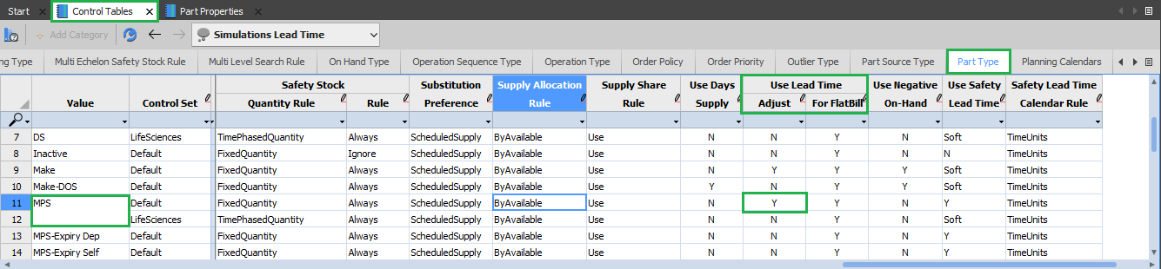
Lead Time Adjust:
Lead Time Adjust rule can be set from Control Table Workbook, Part Type Worksheet, and Use Lead Time Adjust Column.
Lead Time Adjust can be set as Y/N.
At Part Level we change for MPS/MRP values.

Slide 19
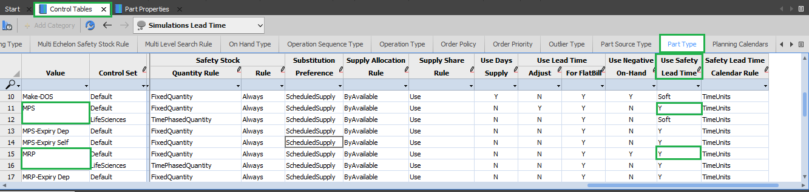
Safety Lead Time:
Safety Lead Time rule can be set from Control Table Workbook, Part Type Worksheet, and Use Safety Lead Time Column.
Safety Lead Time can be set as:
                Y
                N
                Soft
At Part Level we change for MPS/MRP values.

Slide 20
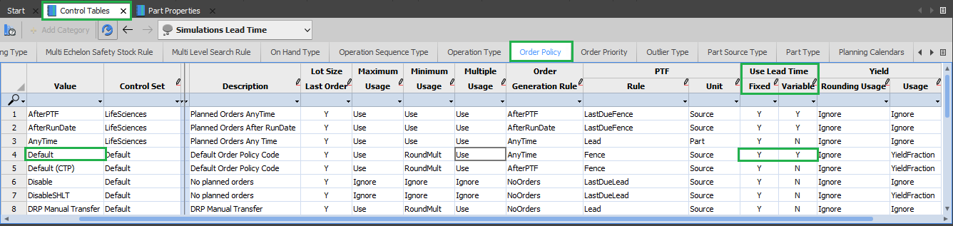
Lead Time (Fixed/Variable):
Lead Time rule can be set from Control Table Workbook, Order Policy Worksheet, and Use Lead Time Column.
Fixed and Variable rule can be set as:
                Y
                N
                Change the lead time values for Default type.

Slide 21
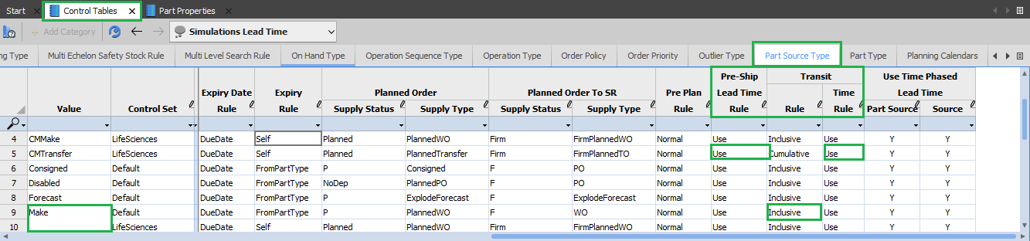
Transit and Pre-Ship:
Transit rule and Pre-Ship Lead Time rule can be set from Control Table Workbook, Part Source Type Worksheet, and Use Transit and Pre-Ship Lead Time Column.
Transit rule can be set as
Inclusive
Cumulative
Transit Time rule and Pre-Ship Time rule can be set as
    Use
    Ignore.
At Part Source Level we change for Make/Buy/Transfer values.

Slide 22
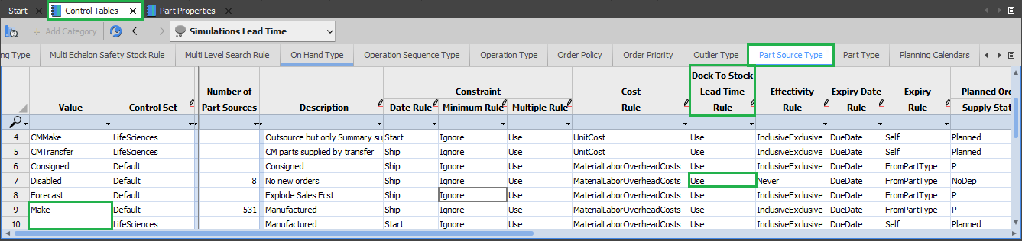
Dock To Stock:
Dock To Stock Lead Time rule can be set from Control Table Workbook, Part Source Type Worksheet, and Use Dock To Stock Lead Time Column.
Dock To Stock Lead Time rule can be set as
    Use
    Ignore.
At Part Source Level we change for Make/Buy/Transfer values.

Slide 23
Inculsive
Make

Slide 24
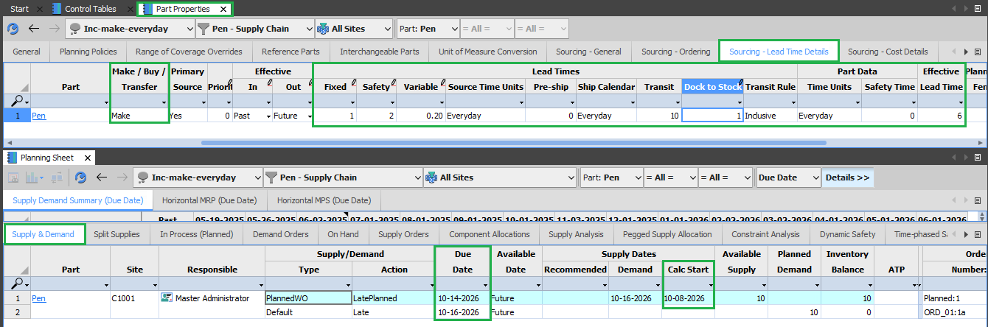
Simulation 1:
Transit Rule: Inclusive
Type: Make
Calendar: Everyday
Site: C1001

Slide 25
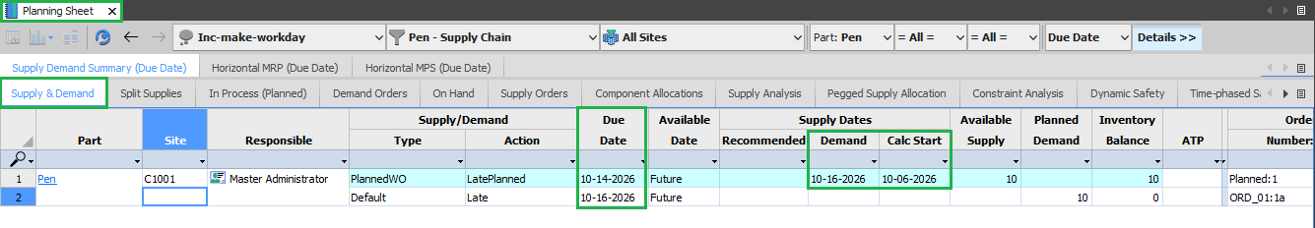
Simulation 2:
Transit Rule: Inclusive
Type: Make
Calendar: Workday
Site: C1001

Slide 26
Inculsive
Transfer

Slide 27
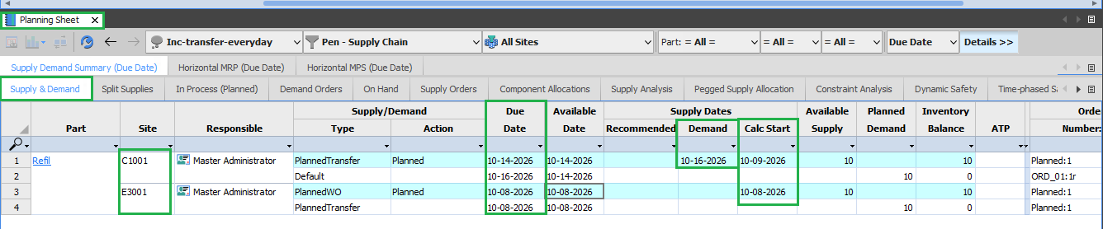
Simulation 3:
Transit Rule: Inclusive
Type: Transfer
Calendar: Everyday
Site: C1001

Slide 28
Simulation 3:
Transit Rule: Inclusive
Type: Transfer
Calendar: Everyday
Site: E3001

Slide 29
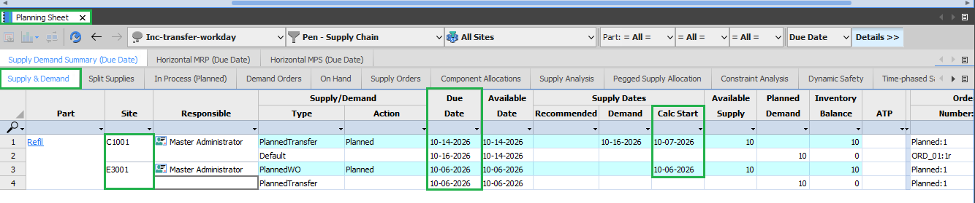
Simulation 4:
Transit Rule: Inclusive
Type: Transfer
Calendar: Workday
Site: C1001

Slide 30
Simulation 4:
Transit Rule: Inclusive
Type: Transfer
Calendar: Workday
Site: E3001

Slide 31
Cumulative
Make

Slide 32
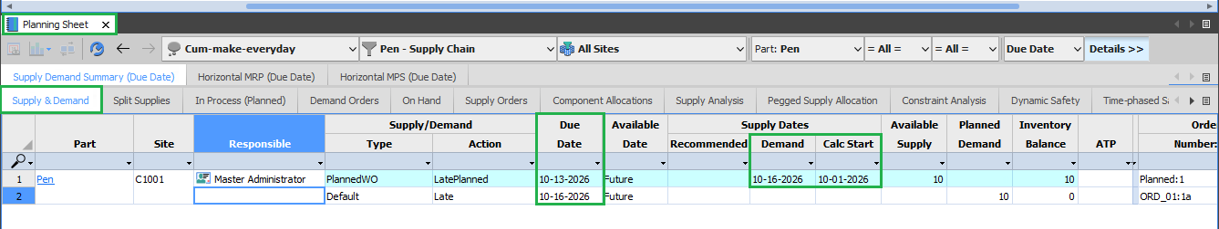
Simulation 5:
Transit Rule: Cumulative
Type: Make
Calendar: Everyday
Site: C1001

Slide 33
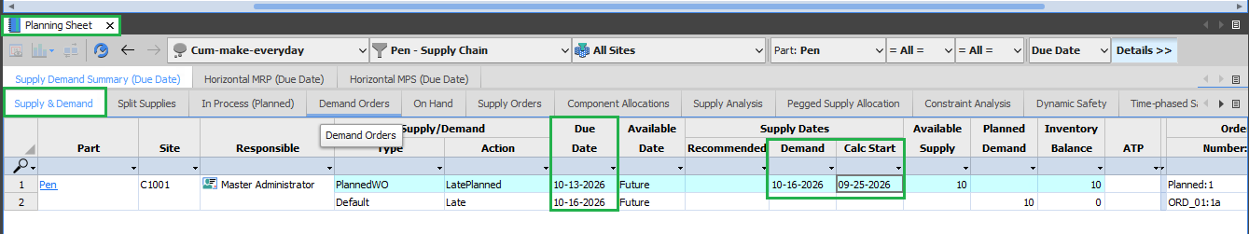
Simulation 6:
Transit Rule: Cumulative
Type: Make
Calendar: Workday
Site: C1001

Slide 34
Cumulative
Transfer

Slide 35
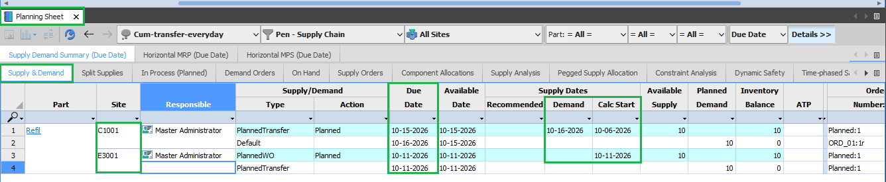
Simulation 7:
Transit Rule: Cumulative
Type: Transfer
Calendar: Everyday
Site: C1001

Slide 36
Simulation 7:
Transit Rule: Cumulative
Type: Transfer
Calendar: Everyday
Site: E3001

Slide 37
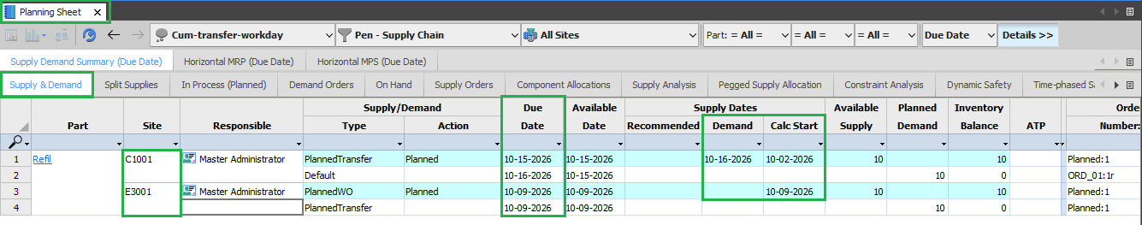
Simulation 8:
Transit Rule: Cumulative
Type: Transfer
Calendar: Workday
Site: C1001

Slide 38
Simulation 8:
Transit Rule: Cumulative
Type: Transfer
Calendar: Workday
Site: E3001

Slide 39
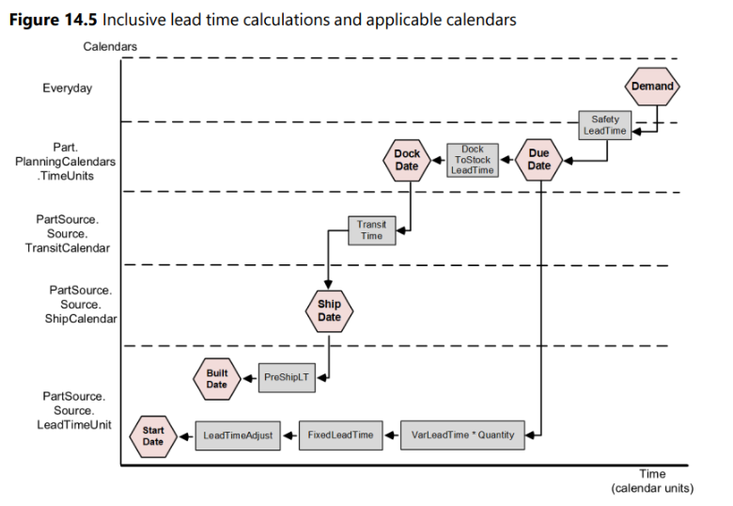

Slide 40
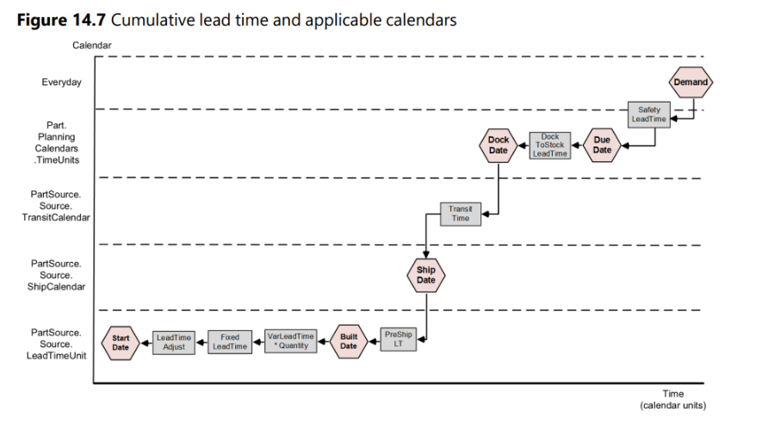
Cumulative lead time:

Slide 42
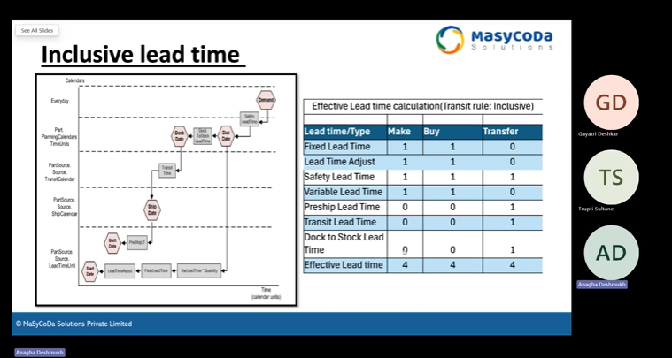
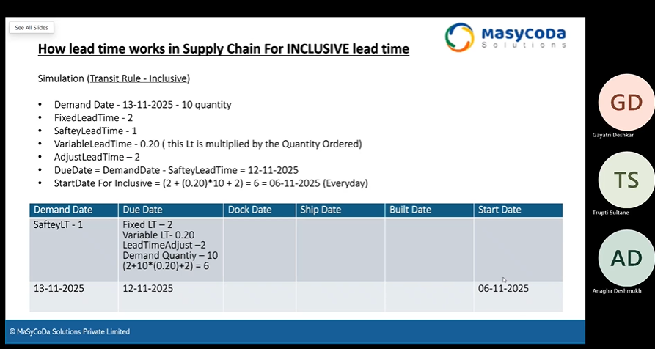

Slide 43
Time Phased

Slide 44
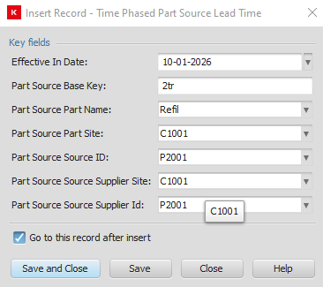
Time phased lead time for Transit rule cumulative, type Transfer. Site C1001 as destination and E3001 as a where the part is made and supplied from
Step:
In the the timephasedpartSourceLeadTime Worksheet we need to first insert record for both supplier and destination site with proper part basekey used while creating supply chain, Part Name, SourceID, Supplier Site and Supplier ID.
Then we can add values to the record and use that in our simulation.
For Site C1001; All the lead time will be considered during simulation based on that it gives us a start date.
But for site E3001 only the Safety, DTS, Transit and Preship values will be considered from site C1001, and all the lead time for E3001 if any will be considered as well.

Slide 45
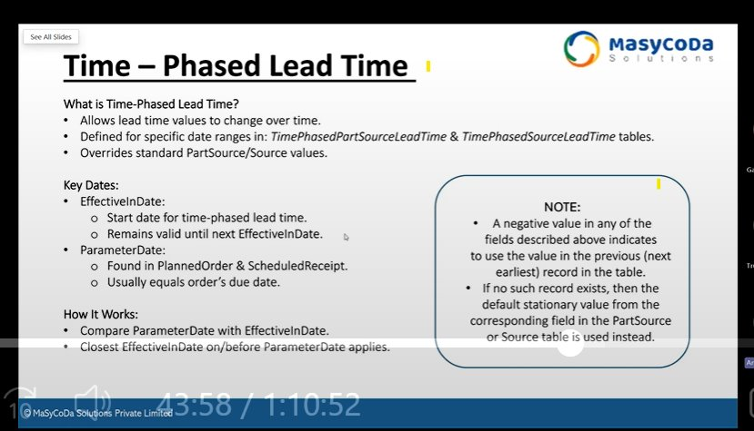

Slide 46
Time Phased Lead Time
Transit Rule: Inclusive
Type: Make
Site: C1001
Safety = 1
DTS = 2
Transit = 2
Pre-ship =1
LTA = 2
Fixed = 2
Variable = 0.2*10 =2
Finding: the values are taken from the a day after effective In date for the demand date as same as effective In date it uses the previous values listed for the demand not the current time phased dates.

Slide 47
Time Phased Simulation 1:
Transit Rule = Inclusive
Demand Quantity = 10.
Part Source Type = Make
Original/ Destination Site = C1001
Demand Date | Due Date | Dock Date | Ship Date | Build Date | Start Date
09/25/2026 | 09/24/2026 | 09/22/2026 | 09/20/2026 | 09/19/2026 | 09/13/2026
10/15/2026 | 10/14/2026 | 10/14/2026 | 10/14/2026 | 10/14/2026 | 10/05/2026
10/20/2026 | 10/19/2026 | 10/19/2026 | 10/19/2026 | 10/19/2026 | 10/09/2026

Slide 49
Time Phased Lead Time
Transit Rule: Cumulative
Type: Make
Site: C1001
Safety = 1
DTS = 2
Transit = 2
Pre-ship =1
LTA = 2
Fixed = 2
Variable = 0.2*10 =2
Finding: the values are taken from the a day after effective In date for the demand date as same as effective In date it uses the previous values listed for the demand not the current time phased dates.

Slide 50
Time Phased Simulation 2:
Transit Rule = Cumulative
Demand Quantity = 10.
Part Source Type = Make
Original/ Destination Site = C1001
Demand Date | Due Date | Dock Date | Ship Date | Build Date | Start Date
09/25/2026 | 09/24/2026 | 09/22/2026 | 09/20/2026 | 09/19/2026 | 09/13/2026
10/01/2026 | 09/30/2026 | 09/28/2026 | 09/26/2026 | 09/25/2026 | 09/19/2026
10/15/2026 | 10/14/2026 | 10/13/2026 | 10/05/2026 | 10/03/2026 | 09/24/2026
10/20/2026 | 10/19/2026 | 10/17/2026 | 10/15/2026 | 10/13/2026 | 10/09/2026

Slide 52
Summary:
Demand Date between the active Effective-In Date will adopt the values from the TimePhasedPartSourceLeadTime and TimePhasedSourceLeadTime only for Fixed Lead Time, Dock To Stock Lead Time and PreShip Lead Time, Transit Time respectfully.
Any Demand Date less than or equal to Effective-In Date will consider values from previous TimePhasedPartSourceLeadTime and TimePhasedSourceLeadTime if provided else it will take the values from the Part Source Table. Example: If a demand date is 10/01/2026 same as Effective-In Date it will consider Lead Time values from the Part Source as it does not have any previous value.
If any Effective –in date is closed it will always consider the TimePhasedPartSourceLeadTime and TimePhasedSourceLeadTime all the time for the future.

Slide 53
Time Phased Simulation 3:
Transit Rule = Cumulative
Demand Quantity = 10.
Part Source Type = Transfer
Original/ Destination Site = C1001
Supplier Site: E3001
All the values highlighted in red color are not considered/ used during calculations.
Dates | Elements | Values (C1001) | C1001 | Values (C1001 + E3001) | E3001
Demand Date |  |  | 10/15/2026 |  | 10/15/2026
Due Date | Safety | 1 | 10/14/2026 | 1 + 0 | 10/14/2026
Dock Date | Dock To Stock | 2 | 10/12/2026 | 2 + 1 | 10/11/2026
Ship Date | Transit Time | 2 | 10/10/2026 | 2 + 2 | 10/07/2026
Build Date | Pre-Ship | 1 | 10/09/2026 | 1 + 1 | 10/05/2026
 | LTA | 2 |  | 2 + 1
 | Fixed | 2 |  | 2 + 1
Start Date | Var*Qtd | 0.2*10 = 2 | 10/03/2026 | 2 + 0 | 10/03/2026

Slide 55
Time Phased Simulation 4:
Transit Rule = Inclusive
Demand Quantity = 10.
Part Source Type = Transfer
Original/ Destination Site = C1001
Supplier Site: E3001
All the values highlighted in red color are not considered/ used during calculations.
Dates | Elements | Values (C1001) | C1001 | Values (C1001 + E3001) | E3001
Demand Date |  |  | 10/15/2026 |  | 10/15/2026
Due Date | Safety | 1 | 10/14/2026 | 1 + 0 | 10/14/2026
Dock Date | Dock To Stock | 2 | 10/14/2026 | 2 + 1 | 10/12/2026
Ship Date | Transit Time | 2 | 10/14/2026 | 2 + 2 | 10/10/2026
Build Date | Pre-Ship | 1 | 10/04/2026 | 1 + 1 | 10/09/2026
 | LTA | 2 |  | 2 + 1
 | Fixed | 2 |  | 2 + 1
Start Date | Var*Qtd | 0.2*10 = 2 | 10/08/2026 | 2 + 0 | 10/07/2026

Slide 56
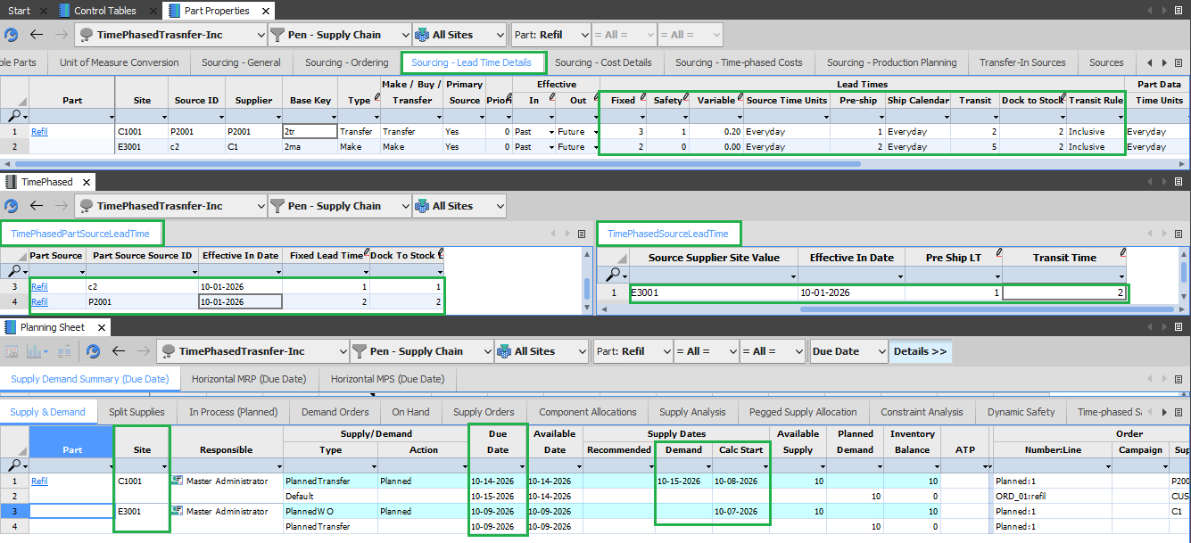

Slide 57
Rounding

Slide 58
Lead Time Rounding:
When a lead time value contains a fractional portion, the effective number of intervals to use in
lead time calculations is determined by rounding as follows:
If the fractional portion is less than .001, the fractional portion is ignored.
Otherwise, if the fractional portion is greater than .001, round up to the next integer.
Assuming an order for 2001 units, the number of days lead time required to build the order is calculated as:
(FixedLeadTime + (quantity * VarLeadTime))
(10 + (2001 * .0005))
(10 + 1.0005)
11.0005 which by rule is rounded down to 11.

Slide 59
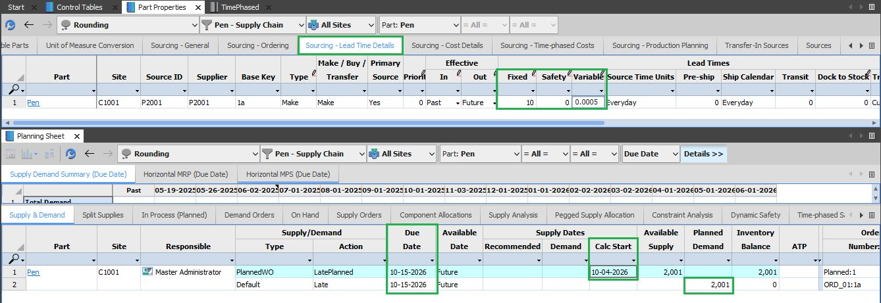

Slide 60
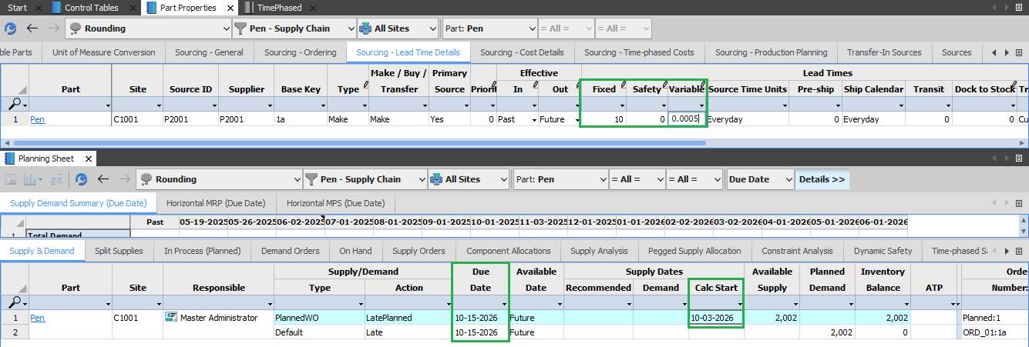
(FixedLeadTime + (quantity * VarLeadTime)) ​
(10 + (2002 * .0005)) ​
(10 + 1.001) ​
11.001 which by rule is rounded down to 12.​

Slide 61
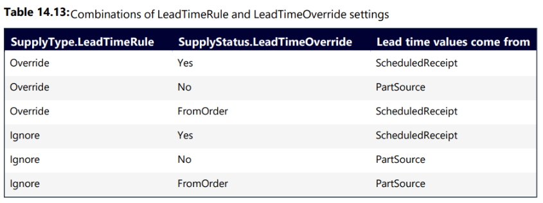
Lead time overrides from scheduled receipts
If necessary, various values stored on the Source and PartSource table used in lead time calculations can be overridden with values stored on a ScheduledReceipt record.

Slide 62
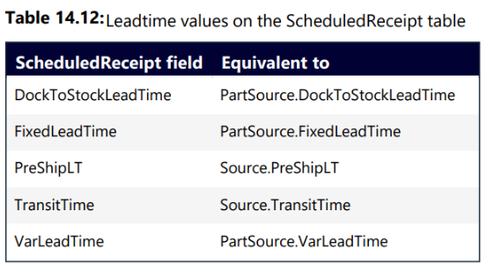
Lead time overrides from scheduled receipts
To use Scheduled Receipt Fields, create a copy of planning sheet and in the private workbook, inside the Supply Order worksheet.
Add additional columns from the table 14.12. Inside a private scenario we can add values to the Scheduled Receipt Fields and see how calculations works.

Slide 63
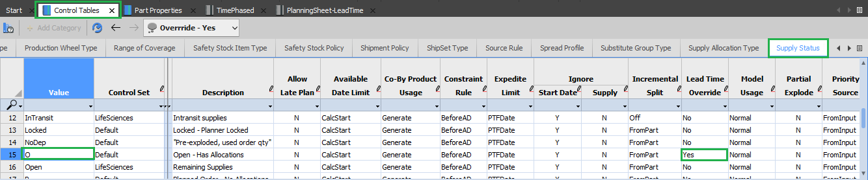
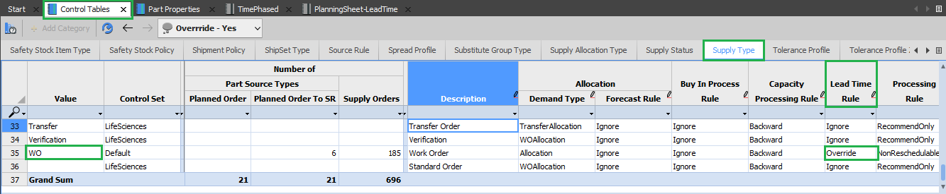
SupplyStatus.LeadTimeOverride
SupplyType.LeadTimeRule

Slide 64
Simulation 1:
SupplyType.LeadTimeRule = Override/Ignore
SupplyStatus.LeadTimeOverride = Yes
Transit Rule = Cumulative
Scheduled Receipt for Qtd (2).
Lead Time Value come from Scheduled Receipt Table. All the Lead time elements are involved in Calculations.
Demand Date | Due Date | Dock Date | Ship Date | Build Date | Start Date
Safety Time (1) | Dock To Stock (2) | Transit Time (3) | Pre-Ship Time (1) | Lead Time Adjust (1)
 |  |  |  | Fixed (2)
 |  |  |  | Variable (1*2)
 | 10/13/2026 | 10/11/2026 | 10/08/11 | 10/07/2026 | 10/02/2026

Slide 65
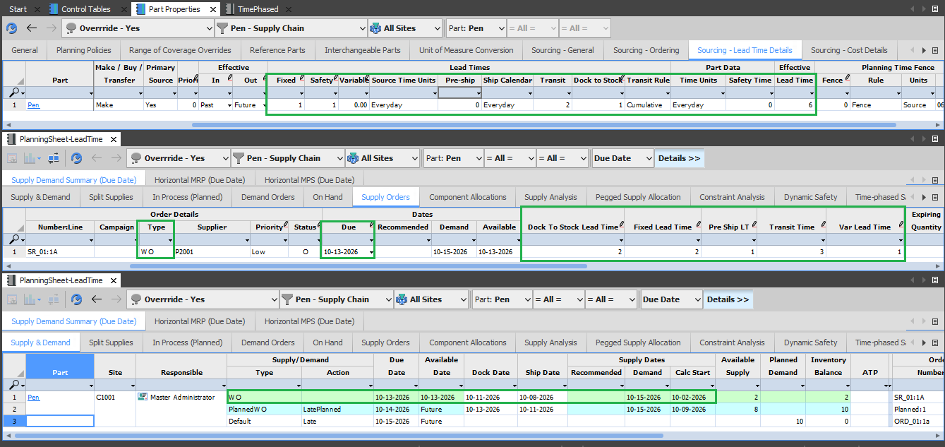

Slide 66
Simulation 2:
SupplyType.LeadTimeRule = Ignore
SupplyStatus.LeadTimeOverride = FromOrder
Transit Rule = Cumulative
Scheduled Receipt for Qtd (2).
Lead Time Value come from Part Source Table. All the Lead time elements are involved in Calculations.
Demand Date | Due Date | Dock Date | Ship Date | Build Date | Start Date
Safety Time (1) | Dock To Stock (1) | Transit Time (2) | Pre-Ship Time (0) | Lead Time Adjust (1)
 |  |  |  | Fixed (1)
 |  |  |  | Variable (0*2)
 | 10/13/2026 | 10/12/2026 | 10/10/2026 | 10/10/2026 | 10/08/2026

Slide 67
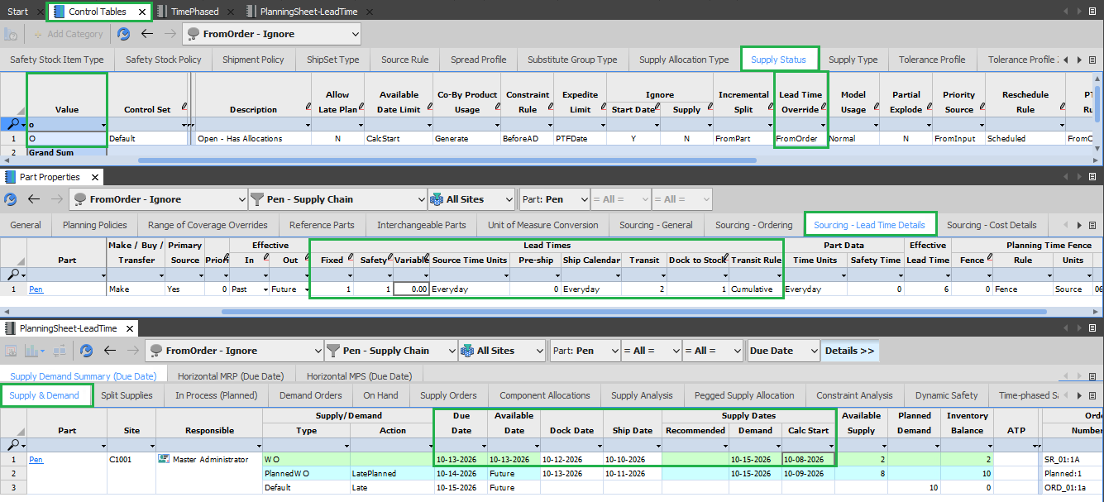

Slide 68
Simulation 3:
SupplyType.LeadTimeRule = Override
SupplyStatus.LeadTimeOverride = FromOrder
Transit Rule = Cumulative
Scheduled Receipt for Qtd (2).
Lead Time Value come from Scheduled Receipt Table. All the Lead time elements are involved in Calculations.
Demand Date | Due Date | Dock Date | Ship Date | Build Date | Start Date
Safety Time (1) | Dock To Stock (2) | Transit Time (3) | Pre-Ship Time (1) | Lead Time Adjust (1)
 |  |  |  | Fixed (2)
 |  |  |  | Variable (1*2)
 | 10/13/2026 | 10/11/2026 | 10/08/11 | 10/07/2026 | 10/02/2026

Slide 69
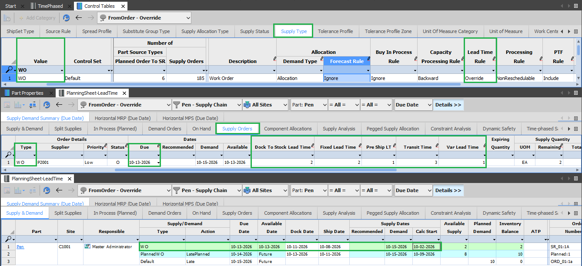

Slide 70
Simulation 4:
SupplyType.LeadTimeRule = Override
SupplyStatus.LeadTimeOverride = FromOrder
Transit Rule = Inclusive
Scheduled Receipt for Qtd (2).
Lead Time Value come from Scheduled Receipt Table, without considering lead time elements DTS, Transit and Pre-Ship Time into calculations.
Demand Date | Due Date | Dock Date | Ship Date | Build Date | Start Date
Safety Time (1) | Dock To Stock (2) | Transit Time (3) | Pre-Ship Time (1) | Lead Time Adjust (1)
 |  |  |  | Fixed (2)
 |  |  |  | Variable (1*2)
 | 10/13/2026 | 10/13/2026 | 10/13/11 | 10/13/2026 | 10/08/2026

Slide 71
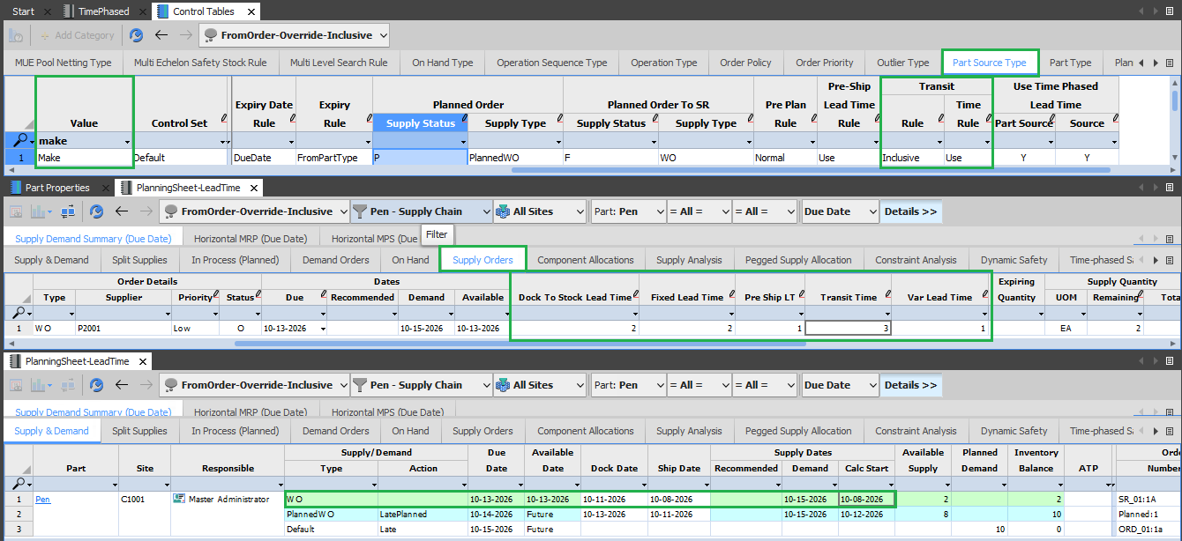

Slide 72
Simulation 5:
SupplyType.LeadTimeRule = Ignore
SupplyStatus.LeadTimeOverride = FromOrder
Transit Rule = Inclusive
Scheduled Receipt for Qtd (2).
Lead Time Value come from Part Source Table, without considering lead time elements DTS, Transit and Pre-Ship Time into calculations.
Demand Date | Due Date | Dock Date | Ship Date | Build Date | Start Date
Safety Time (1) | Dock To Stock (1) | Transit Time (2) | Pre-Ship Time (0) | Lead Time Adjust (1)
 |  |  |  | Fixed (1)
 |  |  |  | Variable (0*2)
 | 10/13/2026 | 10/13/2026 | 10/13/2026 | 10/13/2026 | 10/11/2026

Slide 73
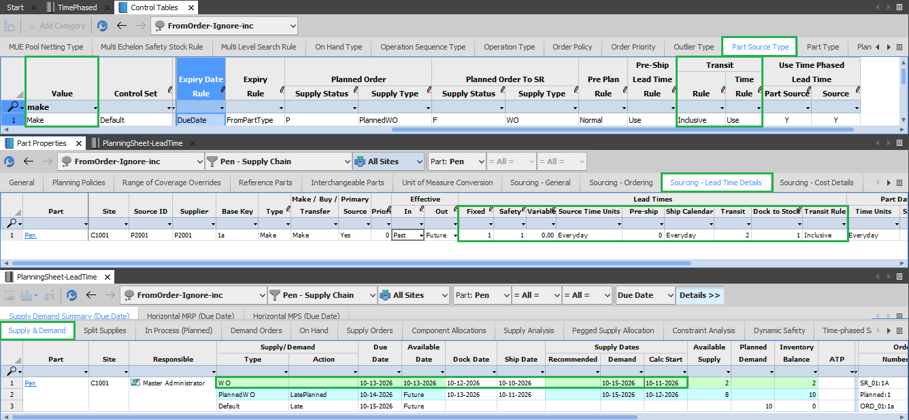

Slide 74
Simulation 6:
SupplyType.LeadTimeRule = Override/Ignore
SupplyStatus.LeadTimeOverride = Yes
Transit Rule = Inclusive
Scheduled Receipt for Qtd (2).
Lead Time Value come from Scheduled Receipt Table, without considering lead time elements DTS, Transit and Pre-Ship Time into calculations.
Demand Date | Due Date | Dock Date | Ship Date | Build Date | Start Date
Safety Time (1) | Dock To Stock (2) | Transit Time (3) | Pre-Ship Time (1) | Lead Time Adjust (1)
 |  |  |  | Fixed (2)
 |  |  |  | Variable (1*2)
 | 10/13/2026 | 10/13/2026 | 10/13/11 | 10/13/2026 | 10/08/2026

Slide 75
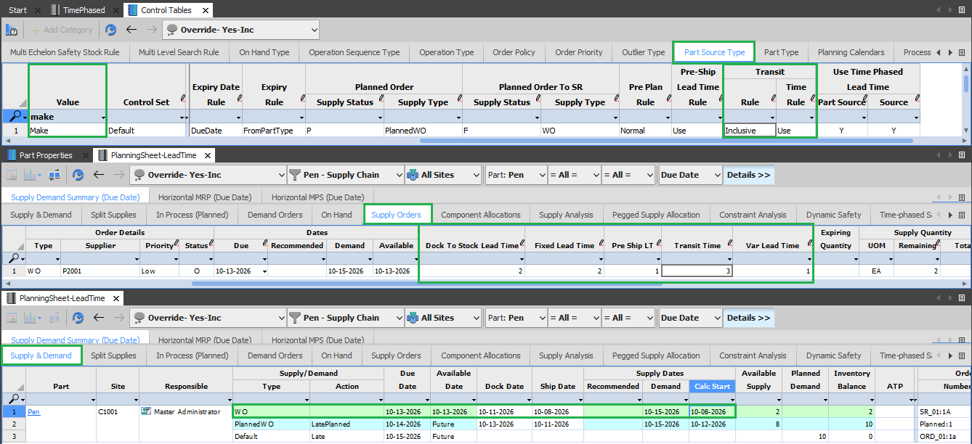

Slide 76
Simulation 7:
SupplyType.LeadTimeRule = Ignore/Override
SupplyStatus.LeadTimeOverride = No
Transit Rule = Cumulative
Scheduled Receipt for Qtd (2).
Lead Time Value come from Part Source Table. All the Lead time elements are involved in Calculations.
Demand Date | Due Date | Dock Date | Ship Date | Build Date | Start Date
Safety Time (1) | Dock To Stock (1) | Transit Time (2) | Pre-Ship Time (0) | Lead Time Adjust (1)
 |  |  |  | Fixed (1)
 |  |  |  | Variable (0*2)
 | 10/13/2026 | 10/12/2026 | 10/10/2026 | 10/10/2026 | 10/08/2026

Slide 77
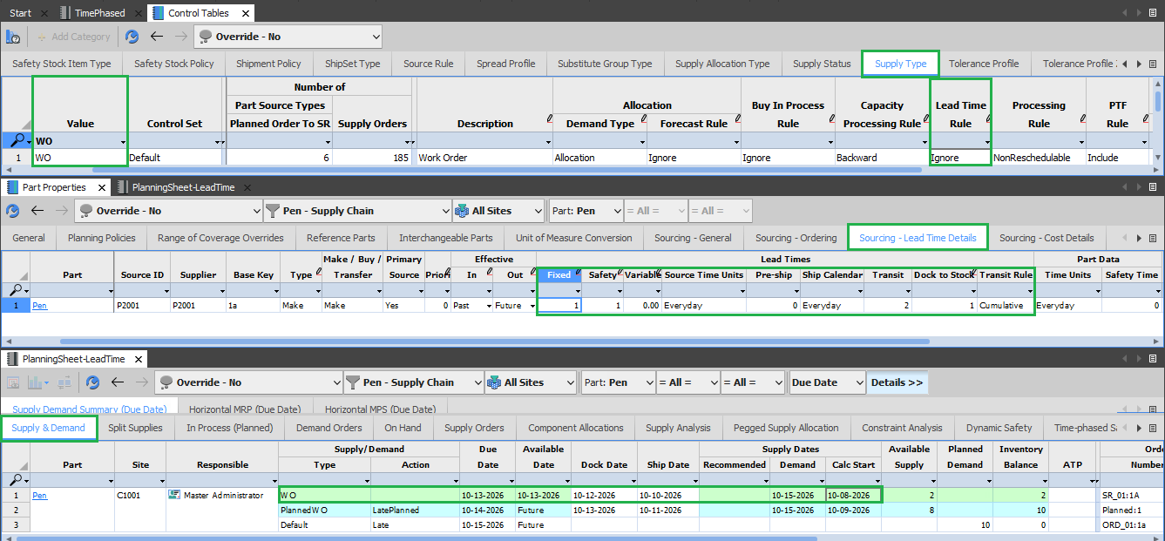

Slide 78
Simulation 8:
SupplyType.LeadTimeRule = Ignore/Override
SupplyStatus.LeadTimeOverride = No
Transit Rule = Inclusive
Scheduled Receipt for Qtd (2).
Lead Time Value come from Part Source Table, without considering lead time elements DTS, Transit and Pre-Ship Time into calculations.
Demand Date | Due Date | Dock Date | Ship Date | Build Date | Start Date
Safety Time (1) | Dock To Stock (1) | Transit Time (2) | Pre-Ship Time (0) | Lead Time Adjust (1)
 |  |  |  | Fixed (1)
 |  |  |  | Variable (0*2)
 | 10/13/2026 | 10/13/2026 | 10/13/2026 | 10/13/2026 | 10/11/2026

Slide 79
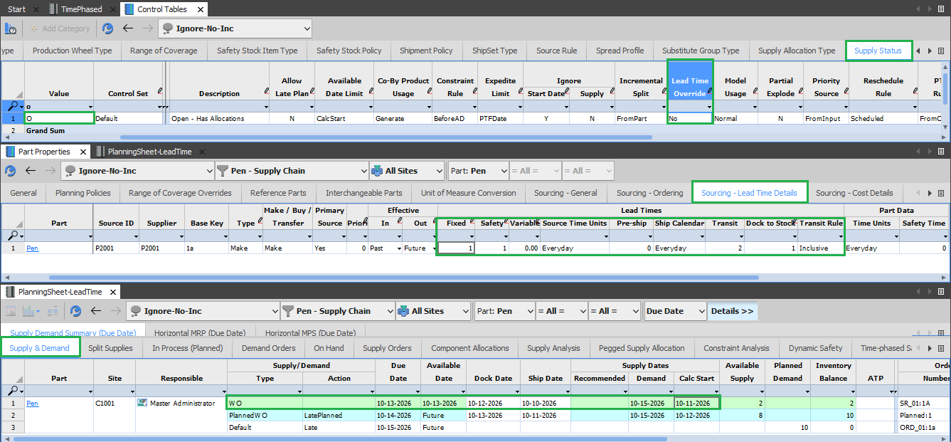

Slide 80
Thank You

